Slide 1
Table of Contents
Introduction
  Problem Statement
  Objectives
Designing AND Implementation
Performance Evaluation
Research Methodology
  Conclusion
  Contribution of this Work
  Future Scope
References

Slide 2
Parallel Bucket Sort on Optical Chained Cubic Tree Interconnection Network
Parallel Bucket Sort used to divides data into buckets and sorts them in parallel.
Uses OCCT network for fast, optical data communication.
Each node sorts locally using multiprocessing
Merges sorted buckets for final output efficiently.

Slide 3
Problem Statement
Efficient Data Distribution Among Processors.
High Inter-Processor Communication Overhead.
Managing a Large Number of Buckets in a Parallel Environment.
Efficient Merging of Sorted Data from Buckets.

Slide 4
Objectives
  To implement the parallel Bucket Sort algorithm in Python.
  To Distribute the data in an OCCT Network.
  To show the Parallel Sorting at Network Node.
  To Visualize the Sorting Process and Data Distribution.

Slide 5
System Design
Divide the data into equal-sized buckets and assign them to nodes before sorting.
Divide the data into ranges and assign each range to a node.
Dynamically adjust the workload of each node during the sorting process to ensure optimal utilization.
All nodes sort their buckets simultaneously and nodes sort their buckets independently, and the system combines the sorted data.
Collect sorted data from each node at a central location .
Combine sorted data from nodes in a distributed manner.

Slide 6
Implementation
Step 1: Data Distribution
Divide Input Data : Divide the input data into buckets based on the range of values.
Assign Buckets to Nodes : Assign each bucket to a node in the OCCT network.
Node Index Calculation: Calculate the node index for each data point using the formula node_index = int((value - min_val) / range_size).

Slide 7
Step 2: Parallel Sorting
Multiprocessing : Use multiprocessing to sort each bucket in parallel.
Node-Level Sorting : Each node sorts its assigned bucket independently using the sort_bucket method.
Parallel Processing : The parallel_sort method creates a separate process for each node to sort its bucket.
Step 3 : Sorted Data Retrieval
Retrieve Sorted Data : Retrieve the sorted data from each node.
Combine Sorted Data: Combine the sorted data from each node into a single sorted list using the get_sorted_data method.
Final Sorting: The final sorted list is obtained by sorting the combined data from all nodes.

Slide 8
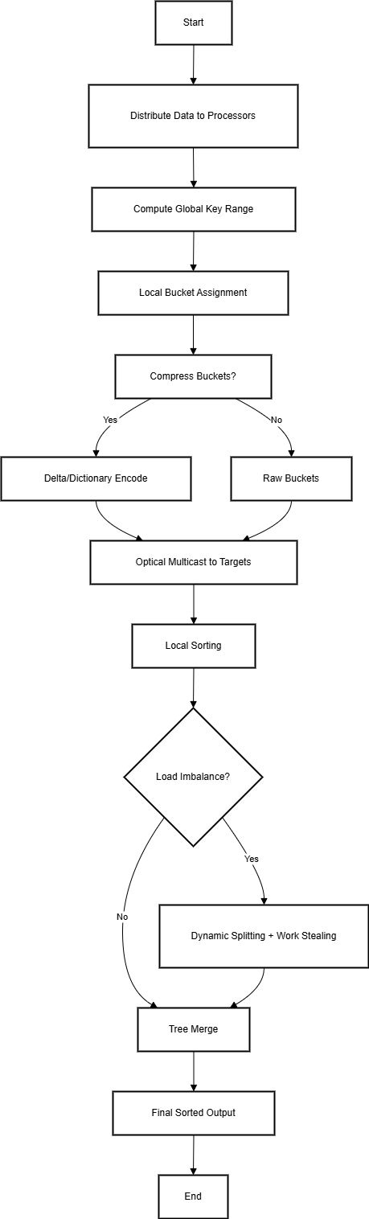
Flow Chart

Slide 9
Analysis
The code implements a parallel bucket sort algorithm using multiprocessing, where each node sorts its assigned bucket in parallel.
The simulate_occt_network function simulates data distribution across nodes in an OCCT network, assigning each node a bucket of data to sort.
The code demonstrates parallel sorting at network nodes using multiprocessing, where each node sorts its assigned bucket independently.
The visualization provides a clear visual representation of the original data, data distribution across nodes, and the final sorted data.

Slide 10
Evaluation
Output:
Unsorted Data: [89, 28, 47, 20, 81, 64, 2, 76, 92, 67, 65, 15, 30, 41, 61, 44, 46, 5, 69,
21, 98, 56, 94, 100, 98, 89, 78, 45, 17, 20, 40, 100, 54, 31, 83, 22, 96, 26, 30, 41]
--- Initializing OCCT Nodes ---
Sorted Data: [2, 5, 15, 17, 20, 20, 21, 22, 26, 28, 30, 30, 31, 40, 41, 41, 44, 45, 46, 47,
54, 56, 61, 64, 65, 67, 69, 76, 78, 81, 83, 89, 89, 92, 94, 96, 98, 98, 100, 100]

Slide 11
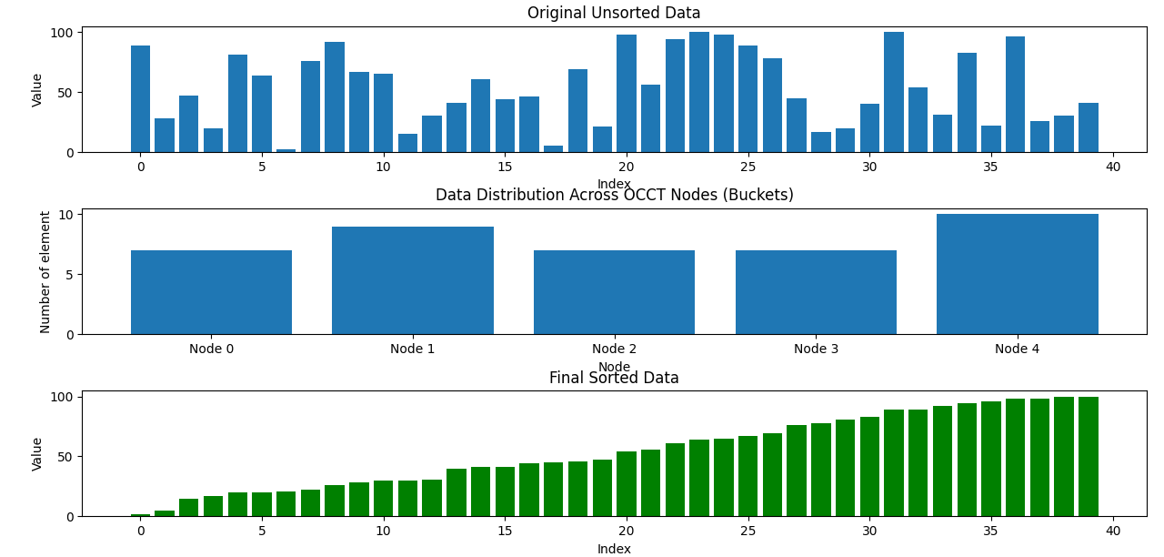

Slide 12
Top Subplot: Original Unsorted Data
This is a bar chart showing the initial state of the data.
The x-axis represents the index of each data point (from 0 to around 40).
The y-axis represents the value of each data point (ranging from 0 to 100).
The bars are arranged in an arbitrary order, reflecting the unsorted nature of the data. You can observe a wide range of values scattered across the indices without any apparent pattern.

Slide 13
Middle Subplot: Data Distribution Across OCCT Nodes (Buckets)
This bar chart illustrates how the original data is distributed into five distinct "OCCT Nodes" (labeled Node 0 to Node 4). These nodes likely represent buckets or partitions created by some data partitioning or indexing mechanism.
The x-axis represents the different OCCT Nodes.
The y-axis represents the number of elements that fall into each node.
We can see that the distribution is not perfectly even. Node 1 and Node 4 contain a larger number of elements compared to Node 0, Node 2, and Node 3. This suggests that the partitioning process resulted in buckets of varying sizes.

Slide 14
Bottom Subplot: Final Sorted Data
X-axis: Labeled "Index," this now represents the position of each data point in the sorted sequence (from 0 to around 40).
Y-axis: Labeled "Value," this still represents the magnitude of each data point (ranging from 0 to 100).
Color: The bars are green, visually distinguishing the sorted data from the original unsorted data (blue bars in the top subplot).
Interpretation: The key observation here is that the bars are now arranged in ascending order from left to right. The height of each subsequent bar is greater than or equal to the height of the preceding bar. This clearly demonstrates that the sorting process has successfully ordered the data points by their value. The previously scattered values from the top subplot are now organized into a nondecreasing sequence.

Slide 15
Conclusion
The Python simulation effectively demonstrates the core principles of parallel sorting on a conceptual OCCT network. It successfully models data distribution into buckets based on value ranges, simulates concurrent sorting of these buckets across multiple nodes using multiprocessing, and visualizes the entire process from the initial unsorted state to the final sorted output. The analysis highlights the potential for significant performance gains through parallelization, although the actual efficiency is noted to be dependent on uniform data distribution. The visualization provides a clear and intuitive understanding of the data flow and the outcome of this simulated parallel sorting algorithm.

Slide 16
The primary goal of this project is to achieve the efficient sorting of a collection of elements through the implementation of the Parallel Bucket Sort algorithm in Python. This algorithm's inherent parallel nature offers the potential for significant performance improvements when sorting large datasets. To evaluate its effectiveness, the implemented algorithm will be tested on a random dataset, providing insights into its real-world performance characteristics, including execution time and resource utilization.

Slide 17
Contribution of your work
Efficient Sorting of Large Datasets: The algorithm can handle large datasets and scale with the number of nodes, making it suitable for big data applications.
Improved Performance: Parallel processing reduces overall sorting time, achieving significant speedup and efficiency gains.
OCCT Network Utilization: The OCCT network's architecture enables fast data transfer between nodes, leveraging optical links for long-distance communication and providing speed and low power consumption.

Slide 18
Future Scope
  Application-Specific Tuning: Creating specialized versions of the algorithm optimized for common data distributions in specific fields.
  Energy Efficiency: Developing power-aware scheduling and data movement strategies for the algorithm on the OCCT.
  Large-Scale Scalability: Thoroughly evaluating the algorithm's performance on larger simulated or emulated OCCT architectures.
  Fault Tolerance: Adapting the algorithm to handle node or link failures within the OCCT network.

Slide 19
References
“Parallel bucket sort algorithm on optical chained-cubic tree interconnection network ” by Basel A. Mahafzah(2023).
“The Optical Chained-Cubic Tree interconnection network: Topological structure and properties” by Mahafzah B. A. K(2012).
The online resources that we have referred to our project:
https://chatgpt.com/
https://gemini.google.com/

